Slide 1
Employee Data Analysis using Excel
STUDENT NAME: ANJALI M
REGISTER NO: 312208912
DEPARTMENT:Bachelor Of Commerce General
COLLEGE: Chevalier T Thomas Elizabeth College For Women

Slide 2
PROJECT TITLE
Employee Performance Analysis using Excel

Slide 3


AGENDA
Problem Statement
Project Overview
End Users
Our Solution and Proposition
Dataset Description
Modelling Approach
Results and Discussion
Conclusion
3/21/2024 Annual Review

Slide 4

PROBLEM STATEMENT
This analysis aims to uncover insights and trends in employee data to inform strategic decisions and drive business growth. By examining key metrics and demographics, we can identify areas for improvement and optimize our workforce for success.

Slide 5

PROJECT OVERVIEW
Analyze employee data to identify trends, patterns, and insights that inform business decisions and drive workforce optimization.
Utilized Excel data analysis tools and techniques to examine employee data, including data visualization, statistical analysis, and trend identification.
The insights gained from this analysis will enable data-driven decisions, enhance employee experience, and drive business growth by optimizing talent management and retention strategies.

Slide 6







WHO ARE THE END USERS?
1. HR Manager
2. Management Team
3. Business Unit Leaders
4. CEO
5.Owner
6. employee

Slide 7

OUR SOLUTION AND ITS VALUE PROPOSITION
Filtering – Helps to remove the empty cells.
Conditional formatting – used to identify the missing cells.
Font(paint) – used to colour the particular column.
Formula – (IFS) Helps to identify the perfomance of employee.
Pivot table- Helps to summarise the employee performance.
Pie chart – show the data of the employee in pivot table.

Slide 8
Dataset Description
Kaagle – Employee Dataset
24 features
10 featureS
First name
Last name
Employee ID
Business unit
Employee status
Gender
Performance
Current Performance rating
Performance level
Employee Type

Slide 9

THE "WOW" IN OUR SOLUTION
Formula :
=IFS(P9>=5,”VERY HIGH”,P9>=4,”HIGH”,P9>=3,”MED”,”TRUE”, “low”)
3/21/2024 Annual Review
9

Slide 10
MODELLING
Step 1: collecting data from Kaagle.
Step 2: identifying the required data.
Step 3: Gathering the required data for employee performance analysis.
Step 4: Colouring the required data with Home tab(font-paint).
Step 5: Using conditional formatting for missing data filtering.
Step 6: Used formula to analys the performance level of employee.
Step 7: With the collected data Inserting the pivot table.
Step 8: From pivot table inserting Pie chart & Bar chart.
10

Slide 11
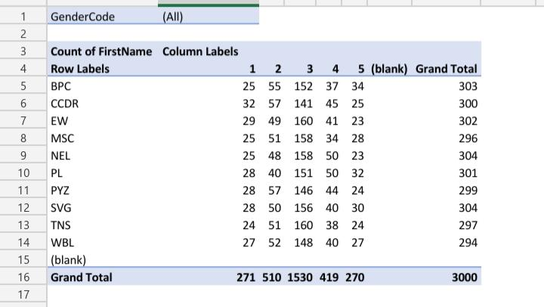
RESULTS
11

Slide 12
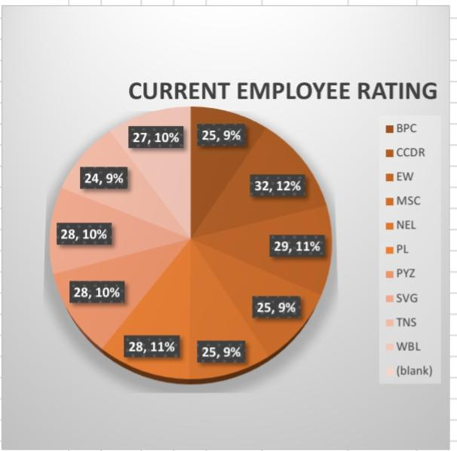
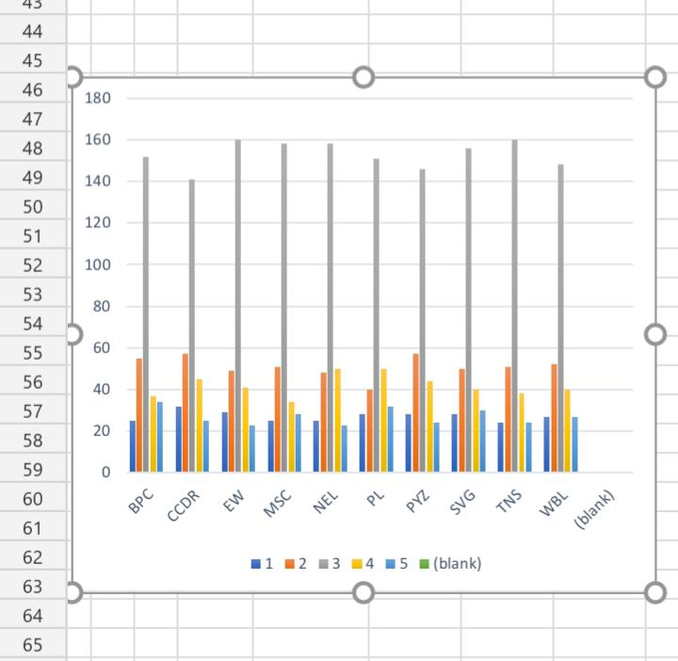

Slide 13
conclusion
The analysis highlights areas for process improvements, allowing for increased efficiency and reduced turnover. Insights gained will enable targeted initiatives to close skill gaps, boost productivity, and enhance overall workforce quality.

